Slide 1
Where The Wild Things Are By Maurice Sendak 1963 Harper Row
A summary by Irene Folkerts

Slide 2
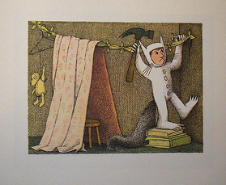
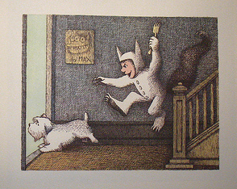
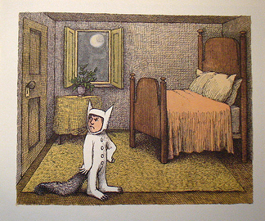
Max was being rather naughty…
so his mother sent him to his room.

Slide 3
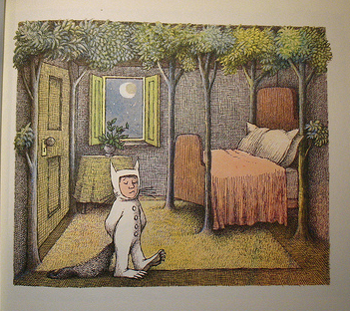
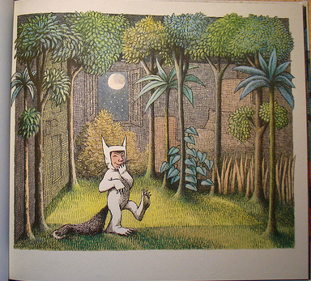
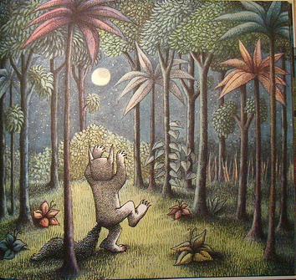
But Max decided he wanted to leave his room. And leave his room he did. He left for a distant land, across a vast ocean, where the wild things are.

Slide 4
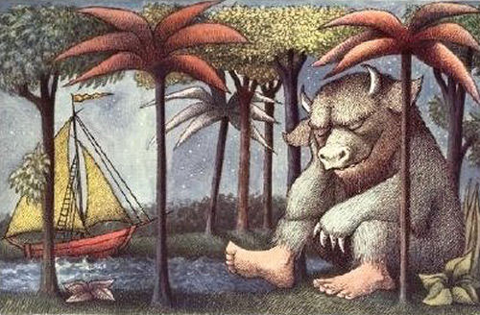
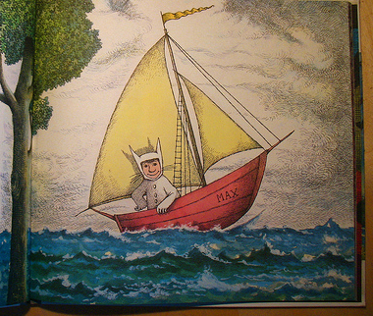
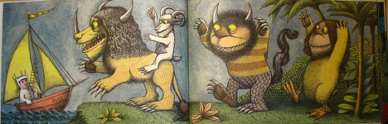
There, he met strange creatures with whom he made fast friends.

Slide 5


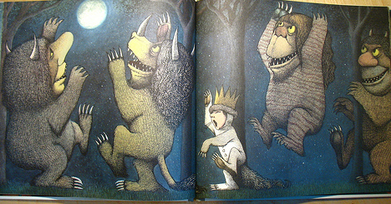
They had lots of kinds of fun.

Slide 6
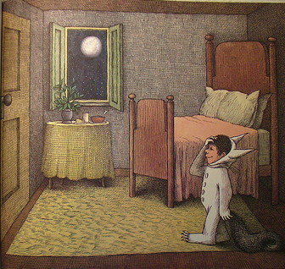
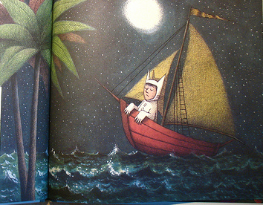
Eventually, Max decided that he should go home. So he sailed across the sea and found himself home with a warm dinner waiting for him. The end.

