Slide 1
Linked Open Data for New Modernist Studies
Jentery Sayers
Assistant Professor, English
Director, Maker Lab in the Humanities
University of Victoria
@jenterysayers | jentery@uvic.ca
MLA Convention 2013 | Boston

Slide 2
Today, with “Avenues of Access” in mind: 1) An introduction to the Modernist Versions Project and some tools we use, 2) Inquiries appearing at scale, 3) An introduction to Linked Modernisms and some influential projects, and 4) A call.

Slide 3
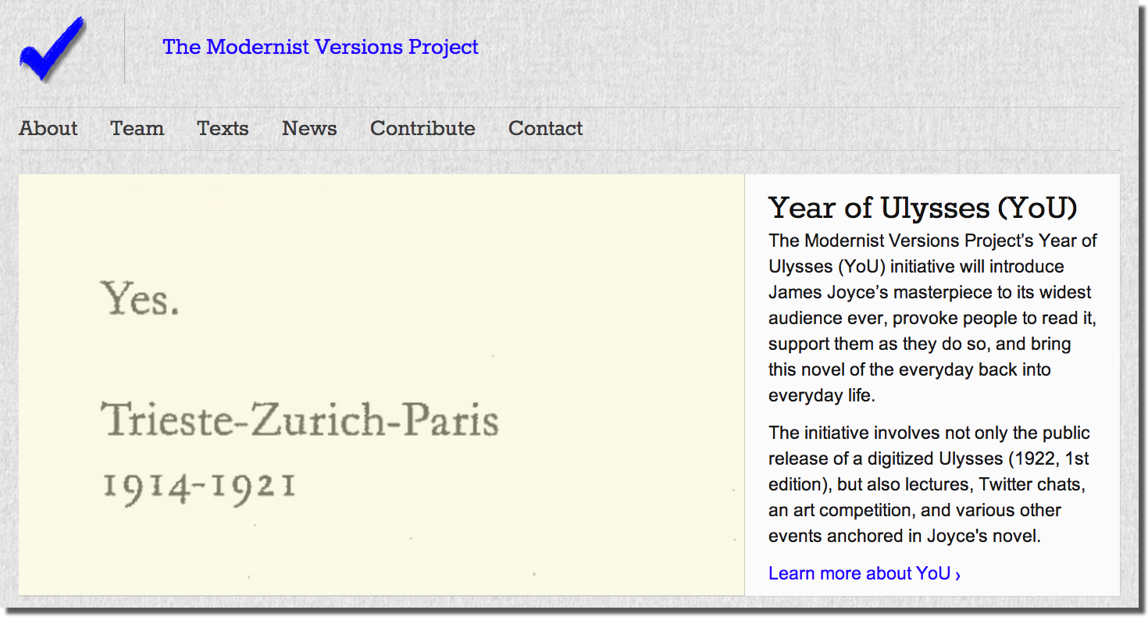
The Modernist Versions Project

Slide 4
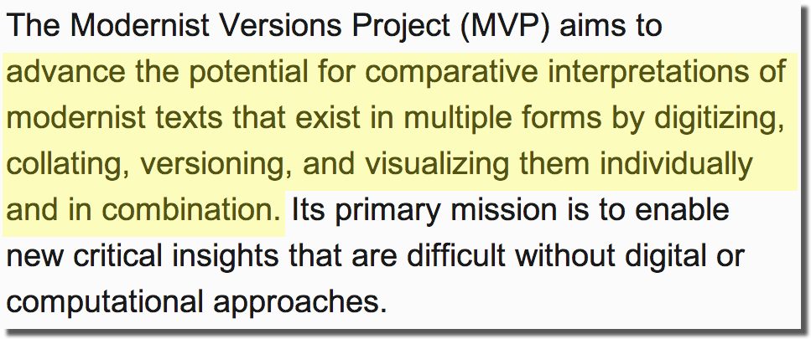
Our Mandate

Slide 5
Juxta Commons

Slide 6
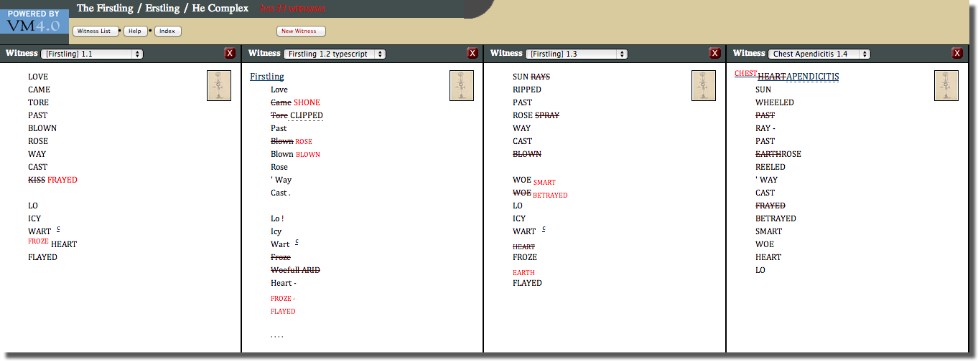
Versioning Machine 4.0
Susan Schreibman (Director)
Tanya Clement (Associate Editor)

Slide 7
Here, accessibility involves: applications aimed at scholarly primitives (Unsworth 2000), such as comparing, annotating, collating, discovering, and representing texts;

Slide 8
Here, accessibility involves: applications aimed at scholarly primitives (Unsworth 2000), such as comparing, annotating, collating, discovering, and representing texts; “clean” texts;

Slide 9
Here, accessibility involves: applications aimed at scholarly primitives (Unsworth 2000), such as comparing, annotating, collating, discovering, and representing texts; “clean” texts; syntactic interoperability;

Slide 10
Here, accessibility involves: applications aimed at scholarly primitives (Unsworth 2000), such as comparing, annotating, collating, discovering, and representing texts; “clean” texts; syntactic interoperability; standards like the TEI;

Slide 11
Here, accessibility involves: applications aimed at scholarly primitives (Unsworth 2000), such as comparing, annotating, collating, discovering, and representing texts; “clean” texts; syntactic interoperability; standards like the TEI; exportable data (encoded and raw); and

Slide 12
Here, accessibility involves: applications aimed at scholarly primitives (Unsworth 2000), such as comparing, annotating, collating, discovering, and representing texts; “clean” texts; syntactic interoperability; standards like the TEI; exportable data (encoded and raw); and open source tools.

Slide 13
But what if we change the scale?

Slide 14
But what if we change the scale?

Slide 15
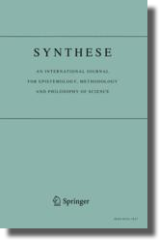
But what if we change the scale?

Slide 16
Enter linked open data . . .

Slide 17
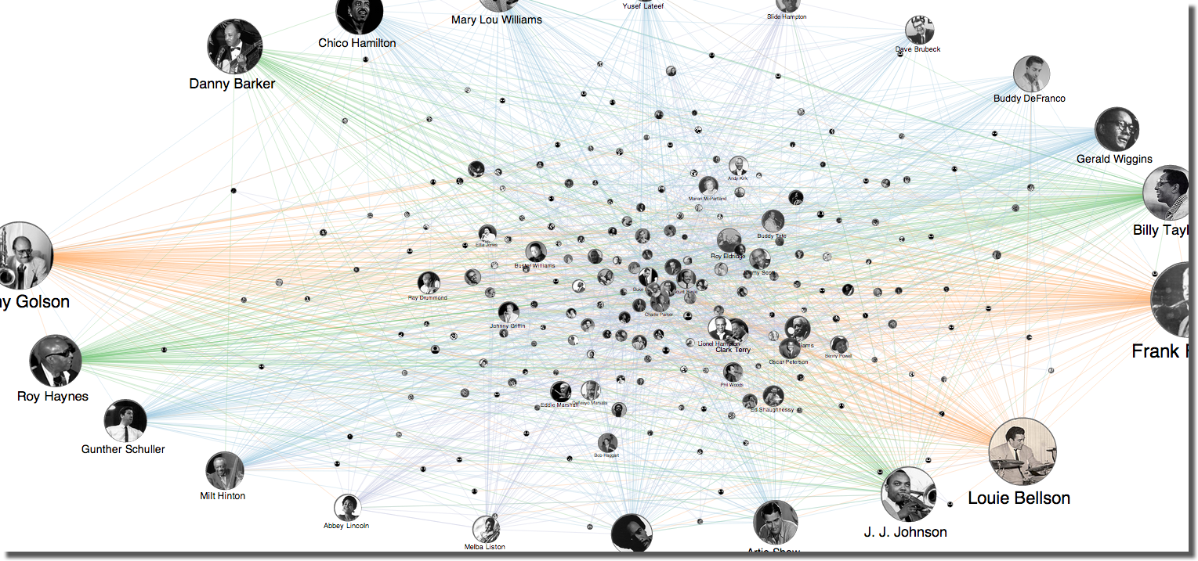
Enter linked open data . . .

Slide 18
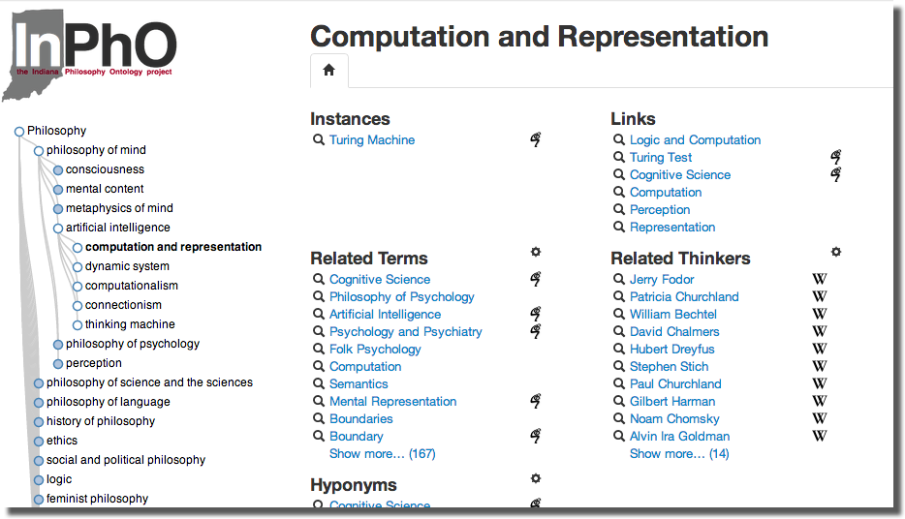
Enter linked open data . . .

Slide 19
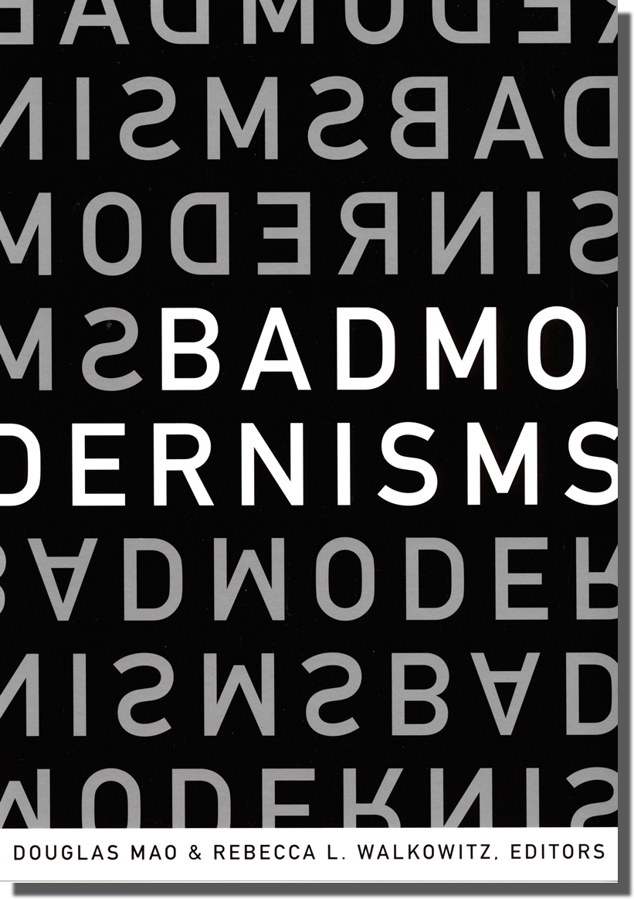
and the New Modernist Studies.

Slide 20
Linked Modernisms, allowing researchers to: discover (perhaps serendipitously) relationships between versions of modernism;

Slide 21
Linked Modernisms, allowing researchers to: discover (perhaps serendipitously) relationships between versions of modernism; visualize and plumb those versions;

Slide 22
Linked Modernisms, allowing researchers to: discover (perhaps serendipitously) relationships between versions of modernism; visualize and plumb those versions; refine queries across subjects, objects, and predicates; and

Slide 23
Linked Modernisms, allowing researchers to: discover (perhaps serendipitously) relationships between versions of modernism; visualize and plumb those versions; refine queries across subjects, objects, and predicates; and develop nuanced understandings across disciplinary, artistic, temporal, linguistic, or geographical articulations of modernism.

Slide 24
But where does the data come from?

Slide 25
But where does the data come from?

Slide 26
But where does the data come from?

Slide 27
But where does the data come from?

Slide 28
But where does the data come from?

Slide 29
Here, accessibility involves: crowdsourcing modernism’s domain experts,

Slide 30
Here, accessibility involves: crowdsourcing modernism’s domain experts, a controlled vocabulary,

Slide 31
Here, accessibility involves: crowdsourcing modernism’s domain experts, a controlled vocabulary, machine-readable data,

Slide 32
Here, accessibility involves: crowdsourcing modernism’s domain experts, a controlled vocabulary, machine-readable data, crosswalks with other initiatives and collections,

Slide 33
Here, accessibility involves: crowdsourcing modernism’s domain experts, a controlled vocabulary, machine-readable data, crosswalks with other initiatives and collections, a public and intelligible taxonomy,

Slide 34
Here, accessibility involves: crowdsourcing modernism’s domain experts, a controlled vocabulary, machine-readable data, crosswalks with other initiatives and collections, a public and intelligible taxonomy, a customized mashup of existing ontologies, and

Slide 35
Here, accessibility involves: crowdsourcing modernism’s domain experts, a controlled vocabulary, machine-readable data, crosswalks with other initiatives and collections, a public and intelligible taxonomy, a customized mashup of existing ontologies, and opening up content, models, and metadata.

Slide 36
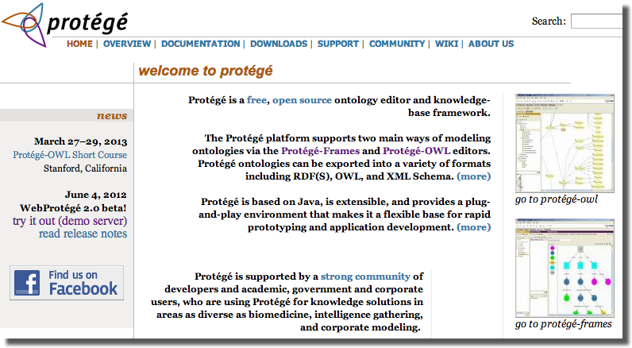
We need tools for writing linked data.

Slide 37
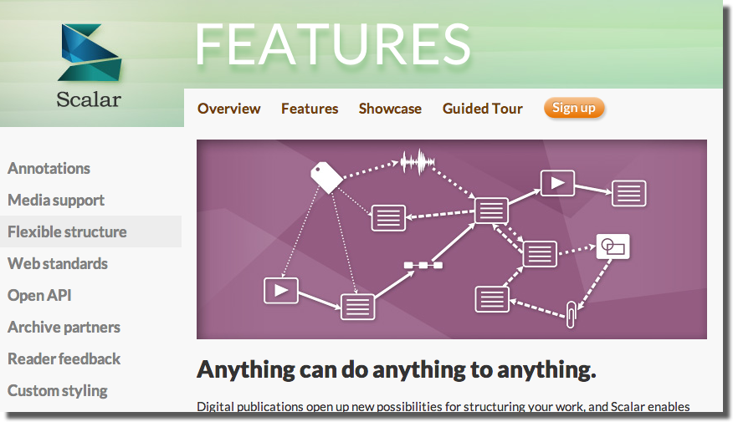
We need tools for writing linked data.

Slide 38
We need tools for writing linked data.

Slide 39
Thank You
Association for Computers and the Humanities
Social Sciences and Humanities Research Council
Susan Brown, Travis Brown, Johanna Drucker, Eric Rochester, Geoffrey Rockwell, and Susan Schreibman
Stephen Ross and the Modernist Versions Project
@jenterysayers / jentery@uvic.ca

